Slide 1
Exploring and Optimizing Data Lakes with PySparkSQL in Azure Databricks
Madiha Aimon

Slide 2
Introduction
This project aims to explore and optimize data stored in an Azure Data Lake using PySparkSQL on the Azure Databricks platform. By leveraging PySparkSQL's functionalities, you'll gain insights into the data and improve its efficiency for further analysis or downstream applications.

Slide 3
Project Overview
The goal of this project is to use PySparkSQL on the Azure Databricks platform to investigate and optimize data contained in an Azure Data Lake. Utilizing PySparkSQL's features will help you understand the data and increase its effectiveness for use in downstream applications or additional analysis.

Slide 4
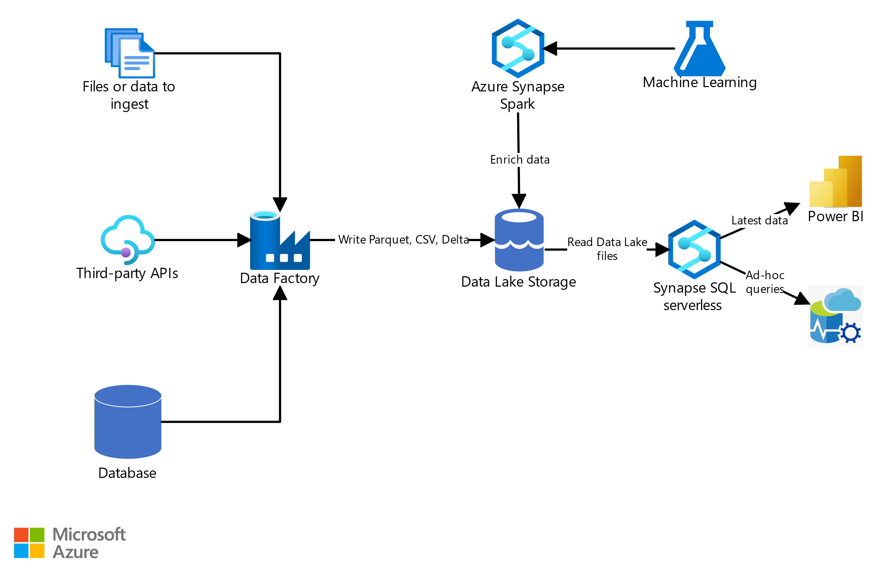
Architecture Diagram

Slide 5
Azure resources used
Azure Databricks Workspace:
Serves as the central platform for creating and managing your Databricks projects, including notebooks, clusters, and data access.
Azure Databricks Cluster:
Provides a scalable compute environment with Apache Spark installed, where your PySpark notebooks execute the data exploration and optimization operations.
Azure Data Lake Storage (ADLS):
Serves as the data source, storing your raw data in various formats like parquet, CSV, etc.

Slide 6
Project Requirements
Format:
Specify the format of the data stored in ADLS (e.g., parquet, CSV, JSON).
Location:
Provide the path to the data location within your ADLS Gen2 storage account. This includes the container name and folder path.
Credentials:
Outline the access method for ADLS. You might need to configure service principals or use managed identities to grant your Azure Databricks cluster access to your ADLS data.
Filtering:
Define specific conditions for filtering data subsets based on specific column values or conditions.
Aggregation:
Specify the desired aggregation operations like calculating averages, sums, or counts across groups of data.

Slide 7
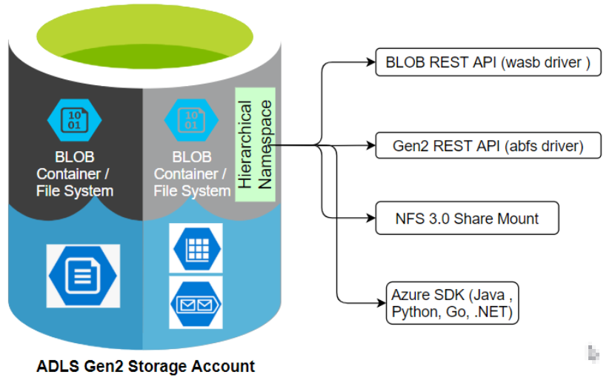
Implementation

Slide 8
Overview of Azure Data Lake
Data Storage
Azure Data Lake provides secure, scalable storage for big data with no limits on capacity.
Data Analytics
It offers analytics through integration with various big data tools and languages.
Security & Governance
Robust security features and governance capabilities ensure data protection and compliance.

Slide 9
Introduction to PySparkSQL
Scalability
PySparkSQL provides scalable SQL interface for handling large-scale data processing.
Integration
Seamless integration with other data processing and machine learning libraries.
Performance
Offers high performance due to in-memory computation and lazy evaluation.

Slide 10
Overview of Azure Databricks platform
Unified Analytics
Provides a collaborative platform for data engineering, data science, and analytics.
Auto-Scaling
Automatically scales resources based on workload demands for cost efficiency.
Workspace
Offers a collaborative workspace with interactive notebooks for streamlined workflows.

Slide 11
Data exploration techniques using PySparkSQL
SQL Queries
Use SQL queries to extract, filter, and aggregate data for exploration.
Data Visualization
Visualize data trends and patterns using various libraries and tools.
Data Profiling
Perform comprehensive data profiling to understand data quality and integrity.

Slide 12
Data optimization techniques using PySparkSQL
Data Partitioning
Partition data for parallel processing and efficient query performance.
File Management Optimization
Compacting
Z-ordering
Data Skipping
Caching

Slide 13
Project Flow
1.The user submits a request to explore and optimize data.
2. The Azure Databricks Workspace manages and allocates
resources (cluster) for the project.
3. The PySpark notebook in the cluster reads data from ADLS.
4. The notebook performs data exploration, transformation, and
optimization.
5. Analysis and insights are generated from the processed data.
6. Optionally, the data can be exported for visualization.
7. Optionally, the insights can be exported to a reporting tool for
further analysis and communication

Slide 14
Visualization in order to Explore Data

Slide 15
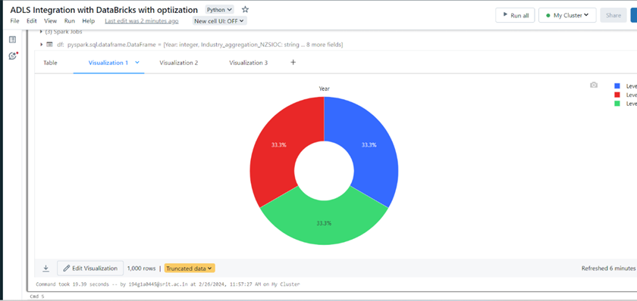

Slide 16
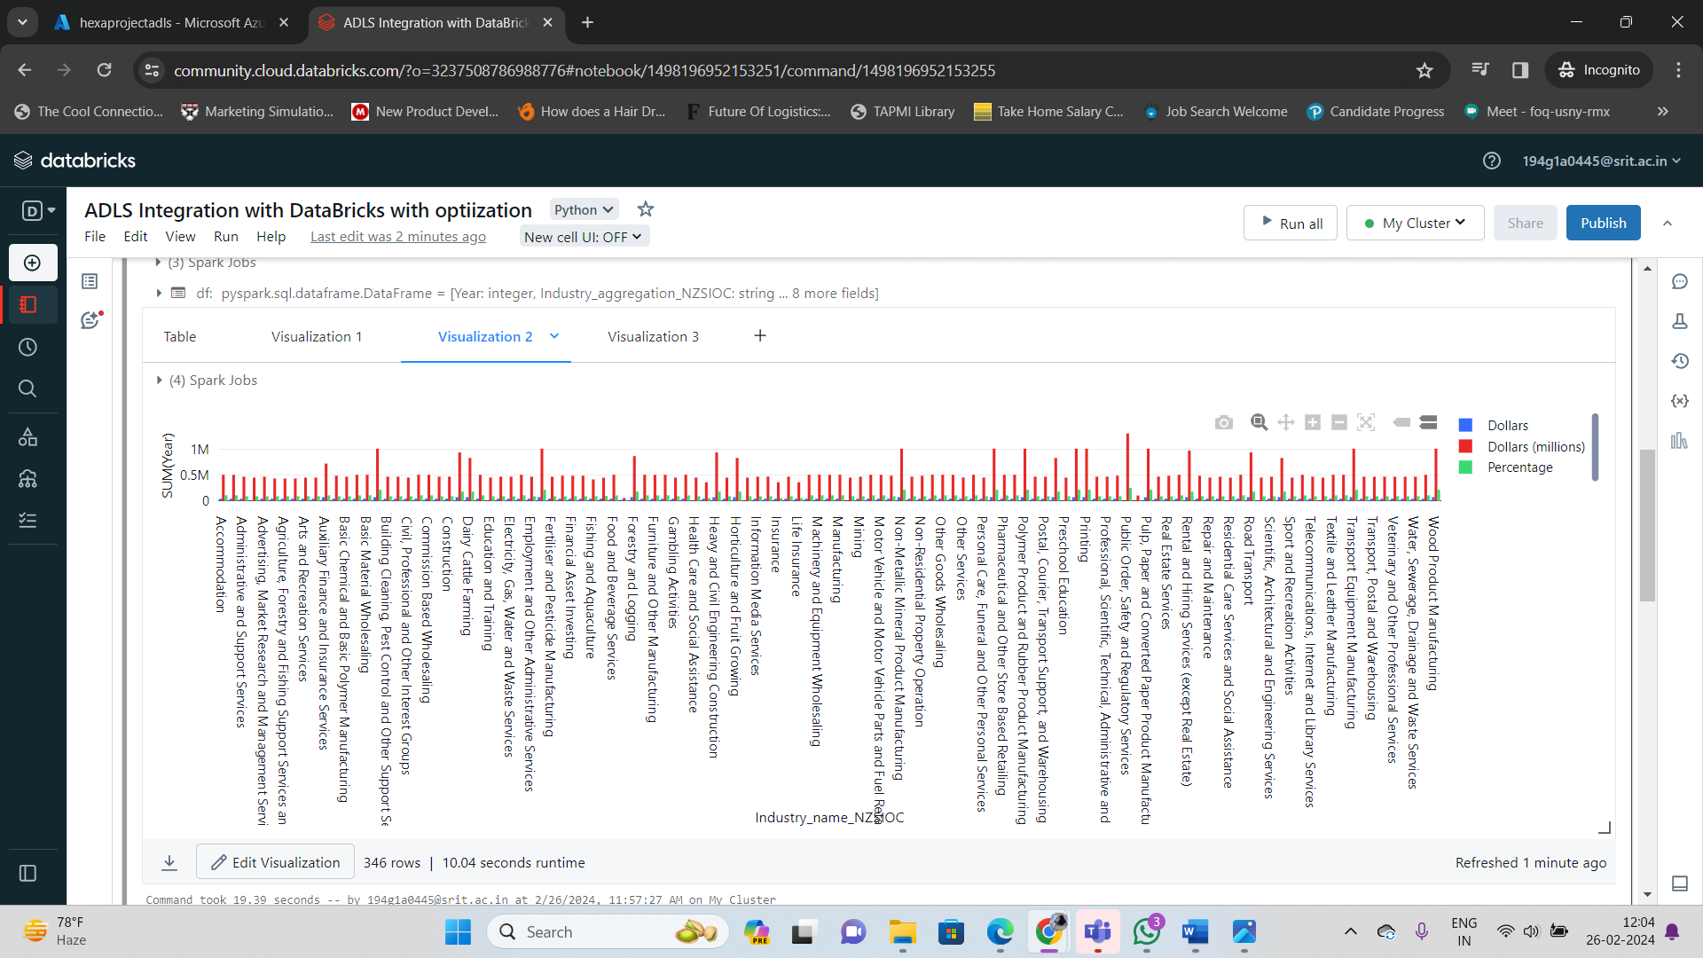

Slide 17
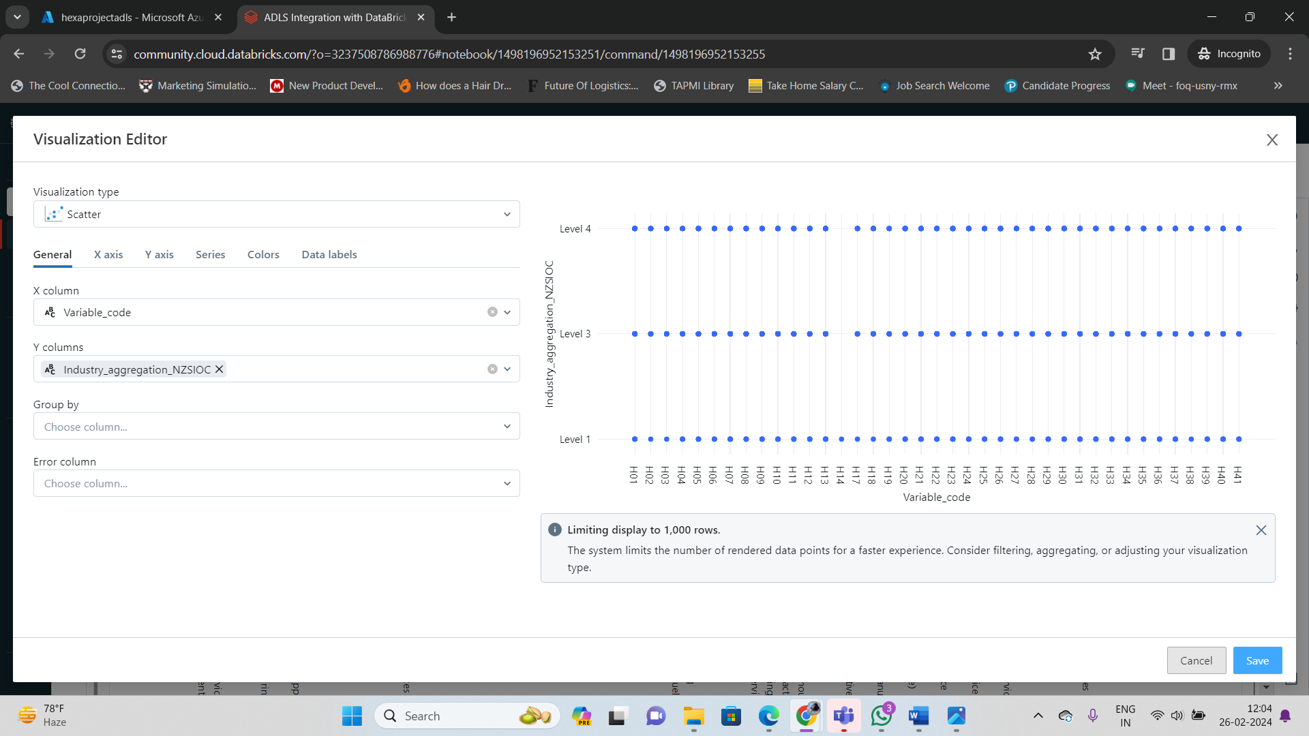

Slide 18
Technologies used
Pyspark
Spark SQL
Delta Lake
Azure Databricks
Azure Data Factory
Azure Date Lake Storage Gen2
Azure Key vault
Power BI(Optional)

Slide 19
Project Scope
This project aimed to explore and optimize a data lake containing sensor data from a network of smart devices.
Data Exploration and Analysis:
Analyze sensor data to identify trends in device performance and energy consumption.
Investigate potential correlations between various sensor readings.
Data Management and Optimization:
Utilize PySparkSQL to clean, filter, and transform the sensor data for efficient analysis.
Implement data partitioning techniques to optimize query performance on large datasets.
Deliverables and Outcomes:
Gain insights into device performance and identify areas for improvement.
Enhance the efficiency and scalability of the data lake environment for future data analysis endeavors.

Slide 20
Conclusion
This project successfully demonstrated the potential of PySparkSQL in Azure Databricks for exploring and optimizing data lakes.

Slide 21
REFERCENCE LINKS:
https://learn.microsoft.com/en-us/azure/architecture/example-scenario/data/synapse-exploratory-data-analytics
https://learn.microsoft.com/en-us/azure/databricks/delta/optimize

Slide 22
Thank You…!

